Slide 1
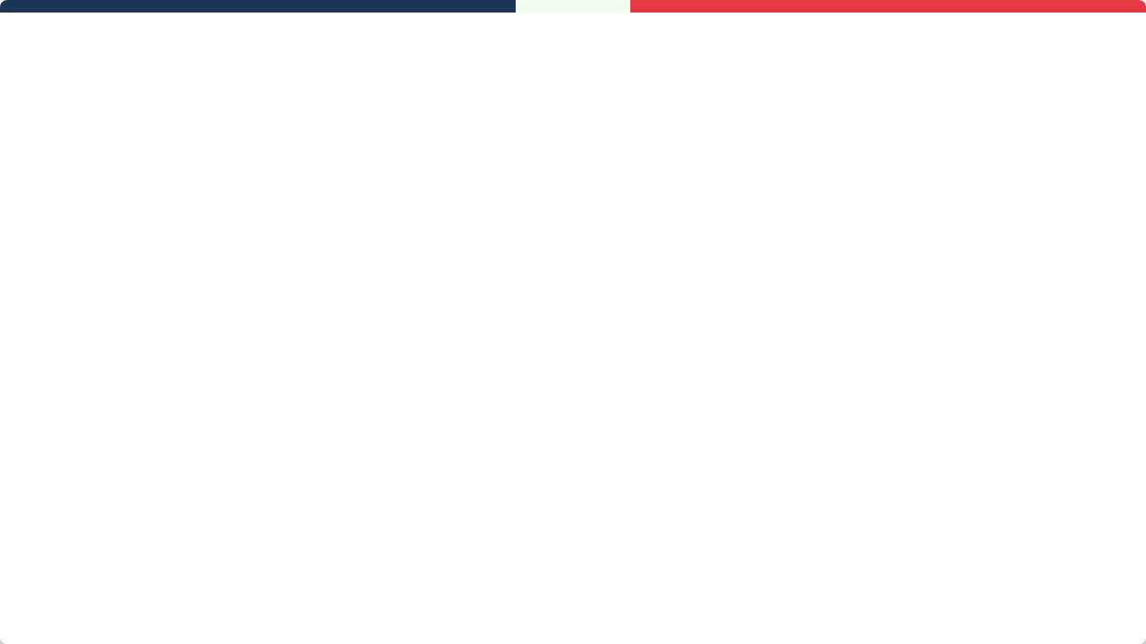

PROJECT DEFENSE & DEMO
ONLINE VOTING MANAGEMENT SYSTEM
Secure, Transparent, and Accessible Ballot Framework

Slide 2


Election Committee
Aadarsha K.C.(PM)
Suwan Dhital (BA)
Subrat Regmi (Lead Dev)
Kriteeka Neupane (Dev)
Riyana Khand(Dev)
Strategy, Scoping & Management
SRS Requirements
Admin panel/Core Backend
Voter Login, UI & Search Implement
Voting Flow

Slide 3
Roles and Responsibilities
Aadarsha K.C.(PM)
Sprint Planning : Work Breakdown Structure of whole 43 user-stories (sprint 1 + sprint2) with proper Jira charts like: sprint burnt down charts, burnup report, etc.
Task Allocation : Role and skill based task allocation ensuring intime work completion.
Team work and coordination: Done different team building activities to make everyone comfortable with each other. Daily standups and weekly updates were done.
Communication & File sharing: Used discord for proper communication and gmail for file sharing & notices
Stakeholder Management: Maintained regular progress reporting to key stakeholders and managed expectations regarding feature delivery and project timelines
Sprint Retrospective: Facilitated Sprint Retrospectives to identify process bottlenecks; implemented 3 workflow improvements that increased team productivity.

Slide 4
Roles and Responsibilities
Suwan Dhital (BA)
Requirement gathering: Researched about core features and functionalities & stakeholder meetings
Documentation & product back log: Sprint backlogs, SRS and other documentation with diagrams.
SRS : Functional & Non-functional requirement authorized in client meetings.
Unit testing & Black box testing: Proper testing is conducted after completion of each feature
Diagrams : Creation of diagrams like Use case, flowchart, ER diagrams , UML and activity diagrams.
System architecture plans & designs : Designed the whole system architecture part and planned resources for implementation.
Live hosting requirement & testing : Gathered resources for live hosting & testing in live environment.
Implementation of monitoring system(wazuh) : Implemented a secure monitoring system named as “Wazuh”

Slide 5
Roles & Responsibility
Subrat Regmi (Lead Dev)
Kriteeka Neupane (Dev)
Riyana Khand(Dev)
Sprint 1: - Admin Dashboard & metrics
-Admin Activity & pool/ candidate
-Admin Login & Security
-Technical - GitHub Repository & Branching Strategy Setup
Sprint 2:
-Login Captcha & Email OTP -Isolation Sensitive Files & Configs
-Web Vulnerabilities mitigations
-bug fixing
Sprint 1:
-UI/UX design (figma)
-Voter Login & Landing page
- Voter verification search -Voter session & access restriction -Secondary verification & Auto Logout
Sprint 2: -Strict single session & timeout
-UI mismatch & duplication solved
-Missing Search & Filter Functionality Across All Data Tables
Sprint 1:
-Ballot Selection ( Info Grid)
-Voter profile & Active pools display
- Voter verification search -Voter confirmation -Live result
Sprint 2: -Simplified UI & Interactive Guide
-UI mismatched- result portal solved
-Improved voter profile navigation content

Slide 6

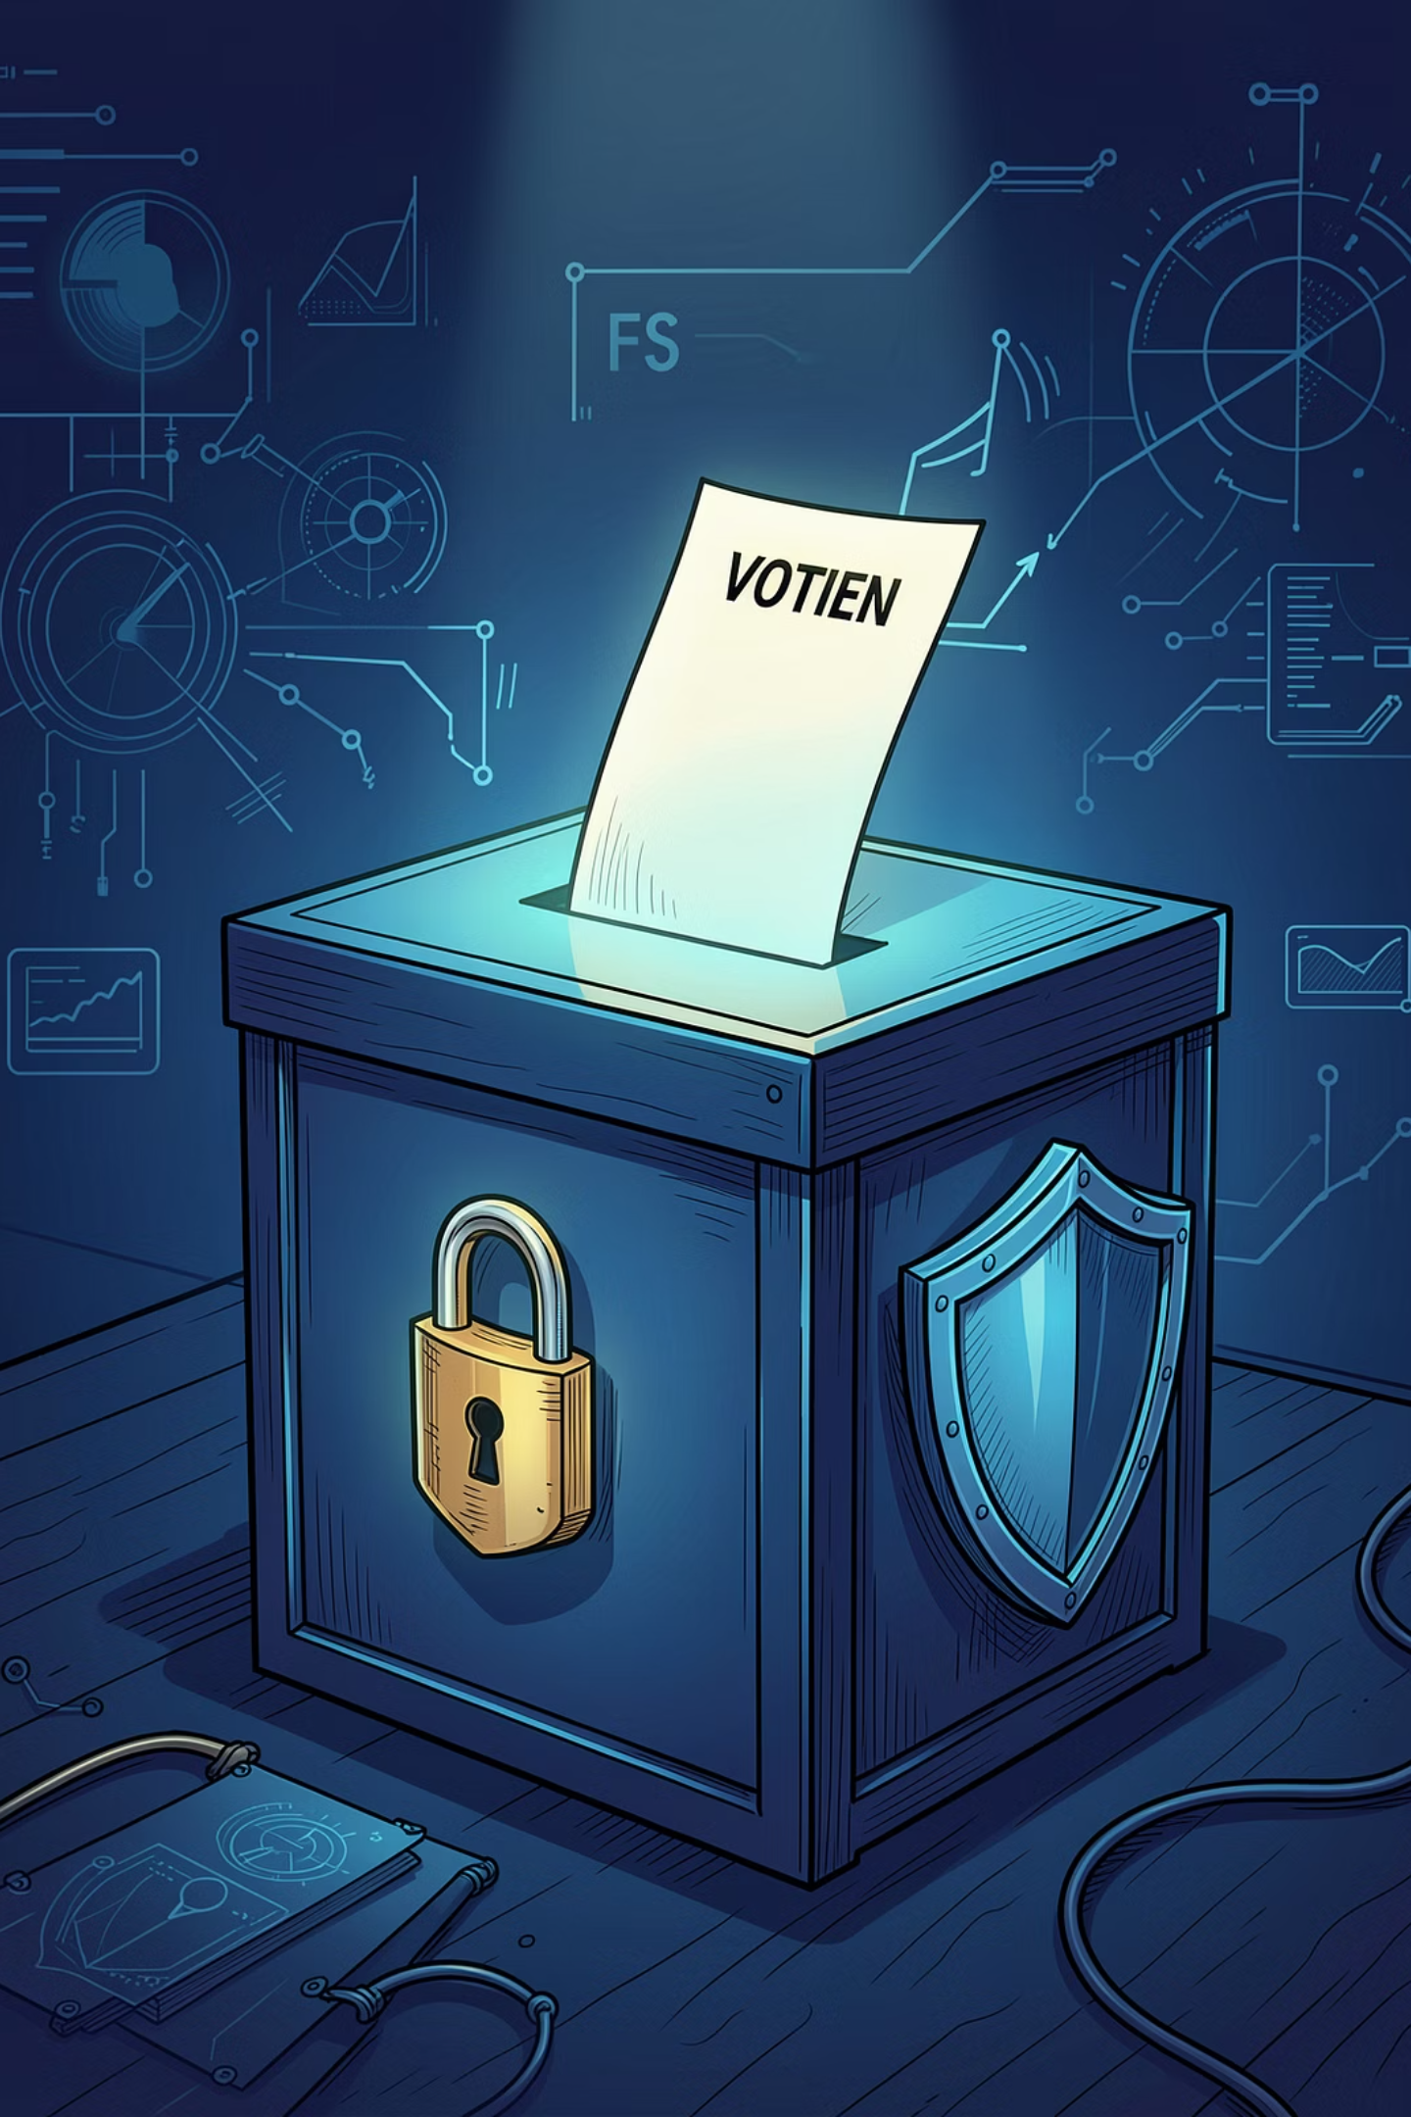
Sprint 1 Delivered(22 user story):
Core functionality & Infrastructure
AUTHENTICATION & ACCESS (5 stories)
Voter Login portal and landing page
Admin security and login management
Voter verification search system
Session control and access restrictions
THE VOTING FLOW (7 stories)
Ballot selection (Information Grid)
Secondary verification modals
Vote confirmation and final submission
Candidate and election pool configuration
DASHBOARDS & METRICS (4 stories)
Admin metrics and activity logging
Voter profile and active pool display
Live public result dashboard
Admin profile management
TECHNICAL FOUNDATION (6 stories)
UI/UX Design and Figma wireframing
GitHub repository and branching strategy
Live hosting, Database, and Deployment setup
NID Integration and Auto-Sync Engine

Slide 7
Sprint 2 Delivered(21 user story):
Security & UI optimization
SECURITY & COMPLIANCE (7 stories)
SSL/TLS enforcement and secure headers
Web vulnerability mitigations
VPN/Proxy implementation and VPN security
Wazuh monitoring and sensitive file isolation
ADVANCED AUTHENTICATION (4 stories)
Login CAPTCHA and Admin Email OTP
Strict single-session and timeout controls
OTP validation and bypass security fixes
Secondary verification logic repair
UI/UX & ACCESSIBILITY (6 stories)
Interactive voter guide and navigation
Search and filter functionality across all tables
Result portal and Dashboard layout cleanup
Mobile-responsive UI mismatch corrections
SYSTEM LOGIC & BUG FIXES (4 stories)
Database crash fixes (Foreign Key constraints)
Proportional Ballot logic (Parties vs. Candidates)
Voter UI: Post-vote pool activity logic
Voter Profile: Navigation content visibility

Slide 8
Challenges & solutions
Attacks and lack of monitoring system:
Soln- Implementation of rate limiting & CDN protection & wazuh for monitoring.
Communication Gaps: Confusion between teammates about the progress of work.
Soln- Conducted daily standups to share progress.
Uneven workload: Some dev have too many while other had less
Soln- If someone is overwhelmed another person taking over task to help.
Code conflicts: Two people working on same file caused conflicts.
Soln- we followed rigid git branching policy where everyone worked on their own branch and solved merge conflicts while merging.
Meeting tight deadlines: With busy schedules and other modules deadline’s, it was hard to finish everything at the end of sprint.
Soln- We used sprint tracking to monitor our speed and and prioritize the user story and done all work according to story points.

Slide 9


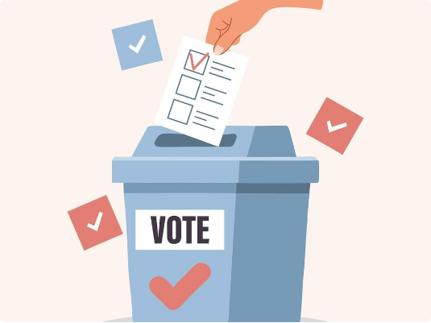
Legacy System Failures
Accessibility: Geographical isolation discourages citizen turnout.
Security: Manual handling increases tampering risks.
Logistics: High cost of physical ballot management.

Slide 10


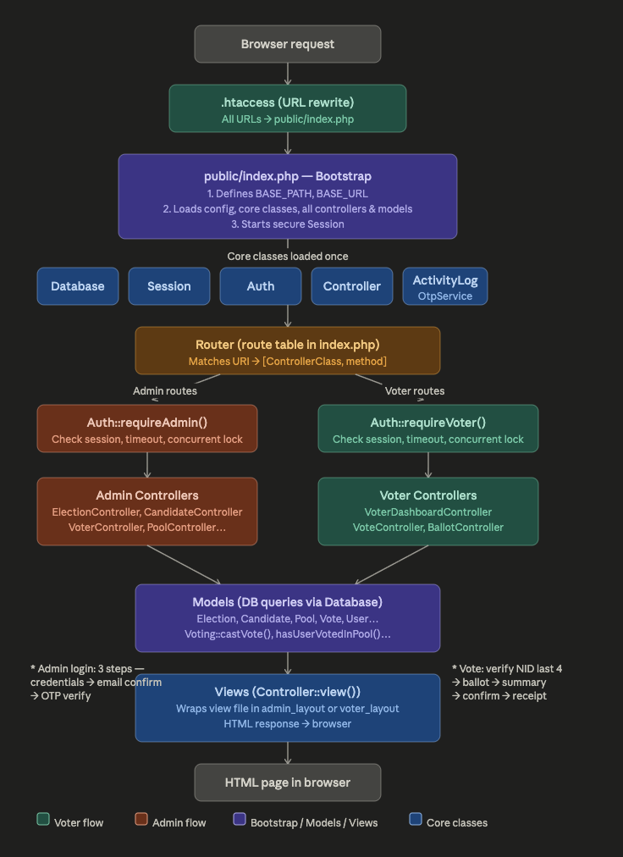
Platform Architecture

Slide 11
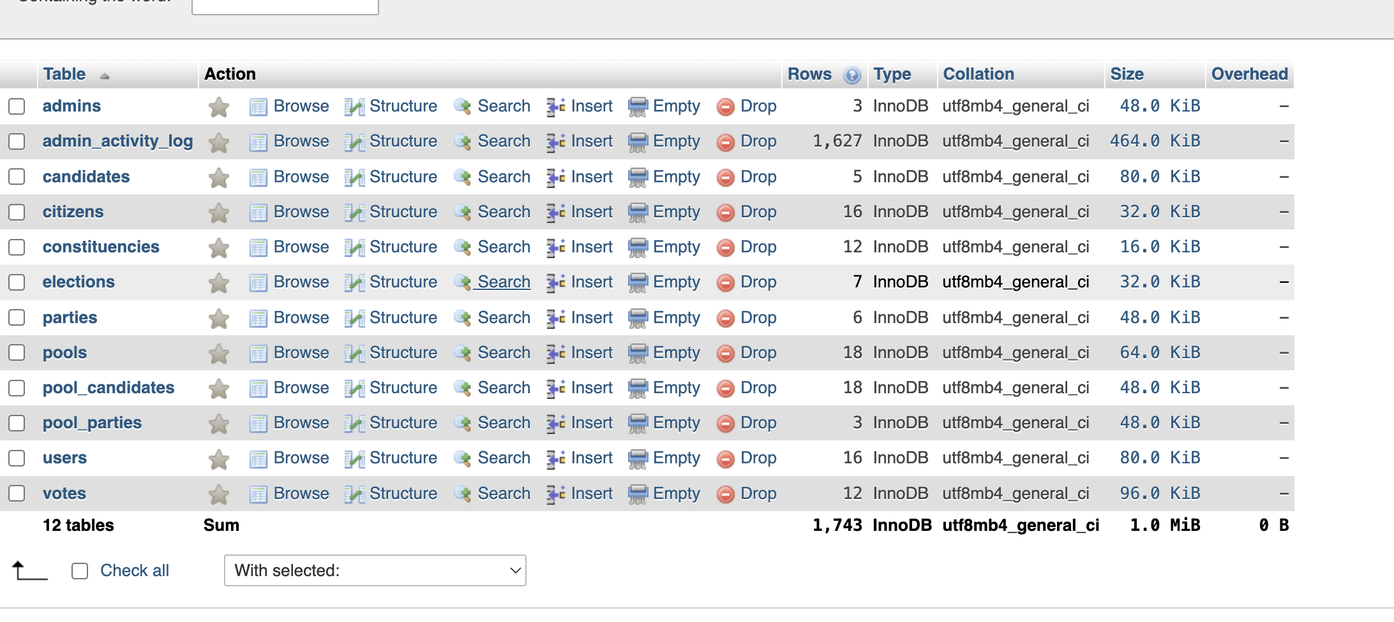
Platform Architecture

Slide 12
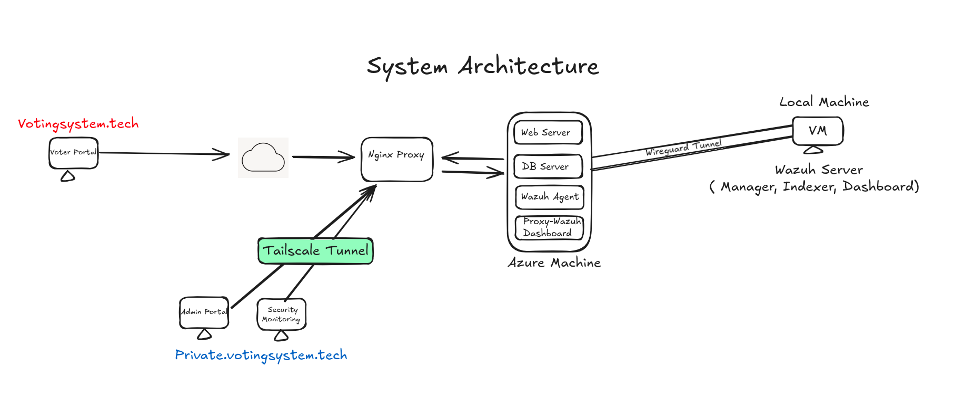
System Architecture

Slide 13

Access Control Matrix
Role | Boundaries
Admins | Setup polling windows and candidate screening.
Voters | Token-based authentication and choice submission.

Slide 14

Agile Lifecycle
Planning
Sprints
(Continuous Integration)CI/CD (Continuous Development)
Launch

Slide 15

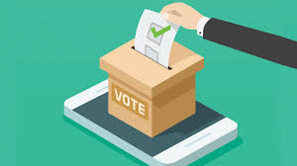
Requirements and Research
Software Requirement Specs (SRS)
Use-Case Matrix & Flow Maps
Research about Voting System

Slide 16


Risk Mitigation
Breaches: Solved with JSON Web Token (JWT) & Bcrypt hashing.
Conflicts: Rigid Git branching policies.
DDOS Attacks: Implementation of rate limiting & CDN protection with wazuh monitoring.
System Reliability (Infra): Automated databases & cloud hosting (AWS/Azure) with 99.9%
Identity fraud(“One person, one vote”): Mitigated with 2FA and unique voter id.
Vote Tampering(Data Integrity): Immutable audit logs to ensure votes cannot be altered once cast.

Slide 17

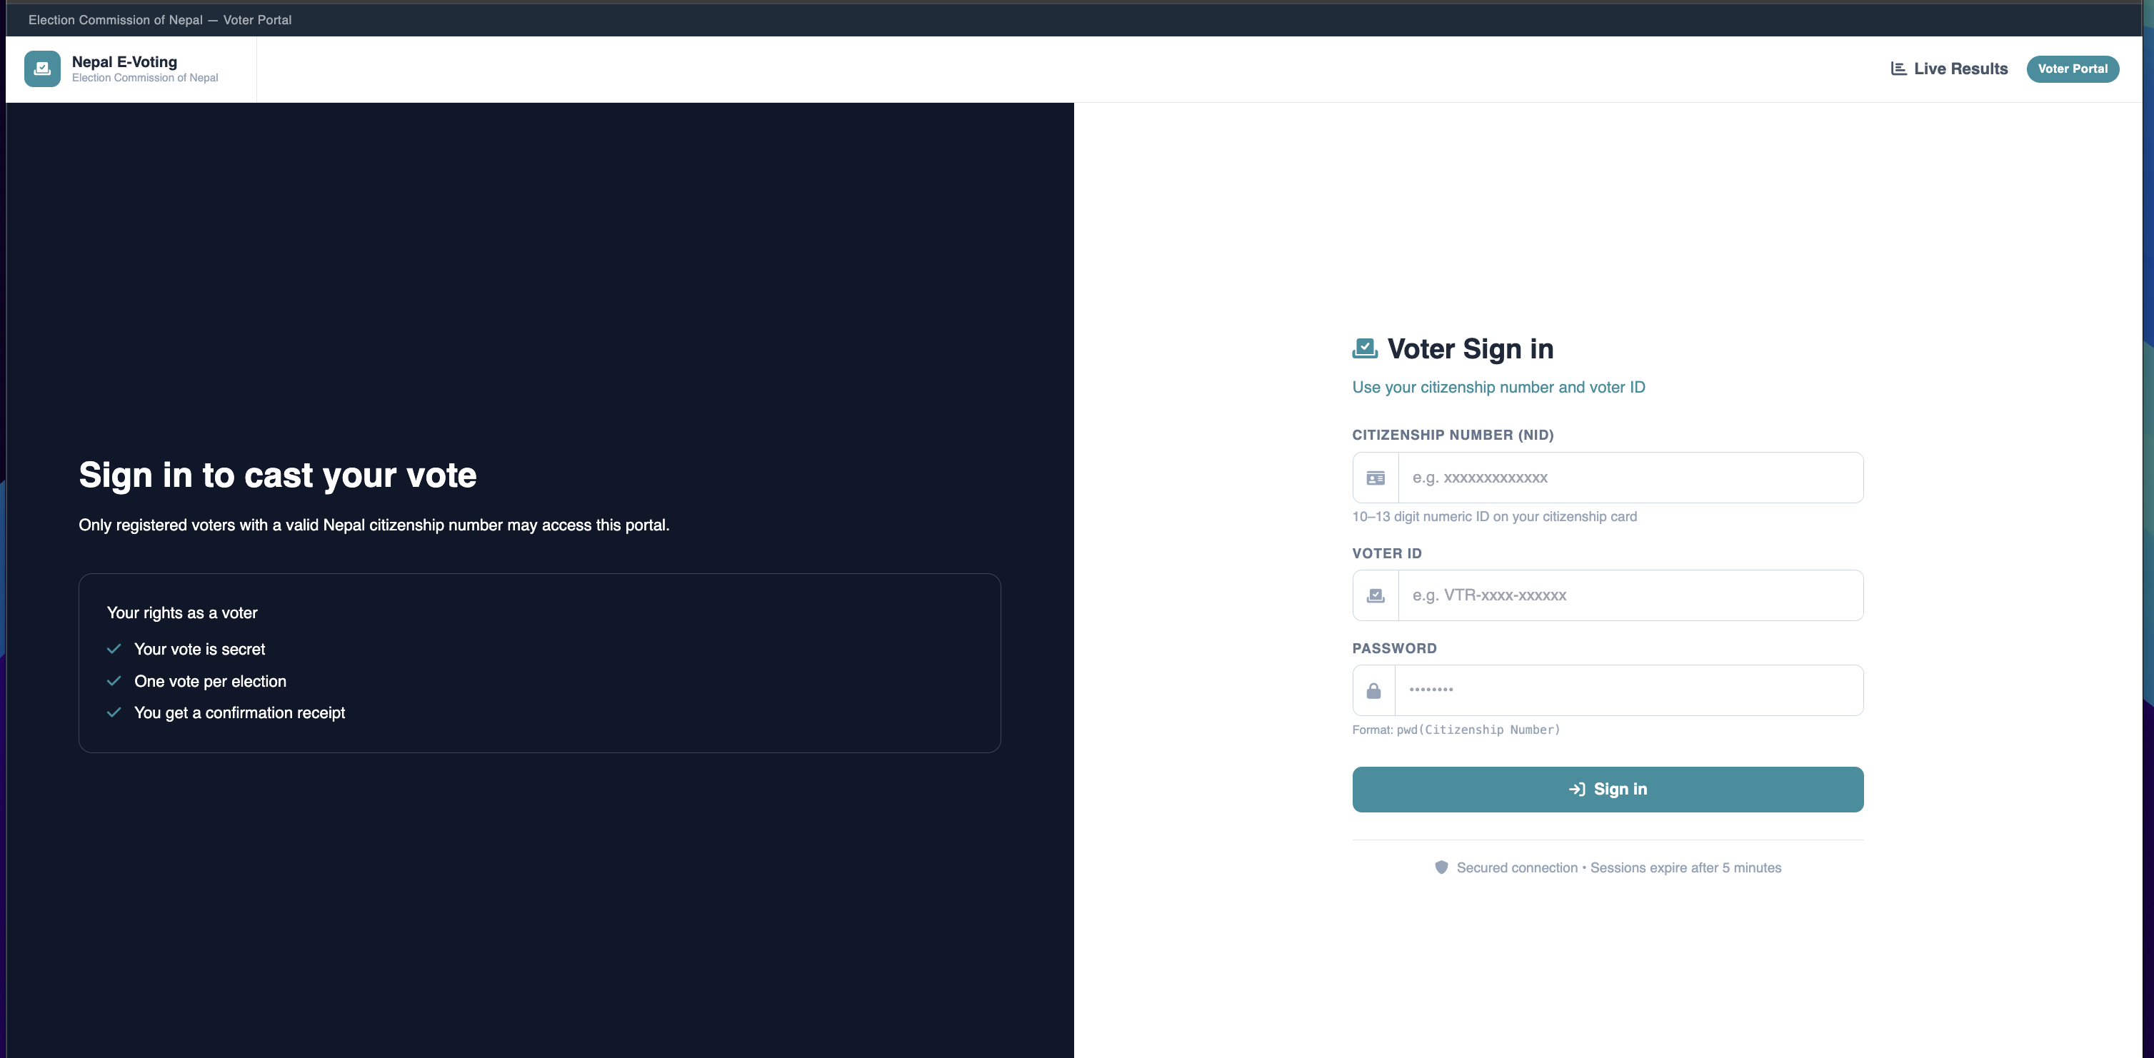
UI Prototype
Our prototype integrates secure voter journeys with robust voter oversight.
Secondary NID verification integration
Real-time Tabulation

Slide 18
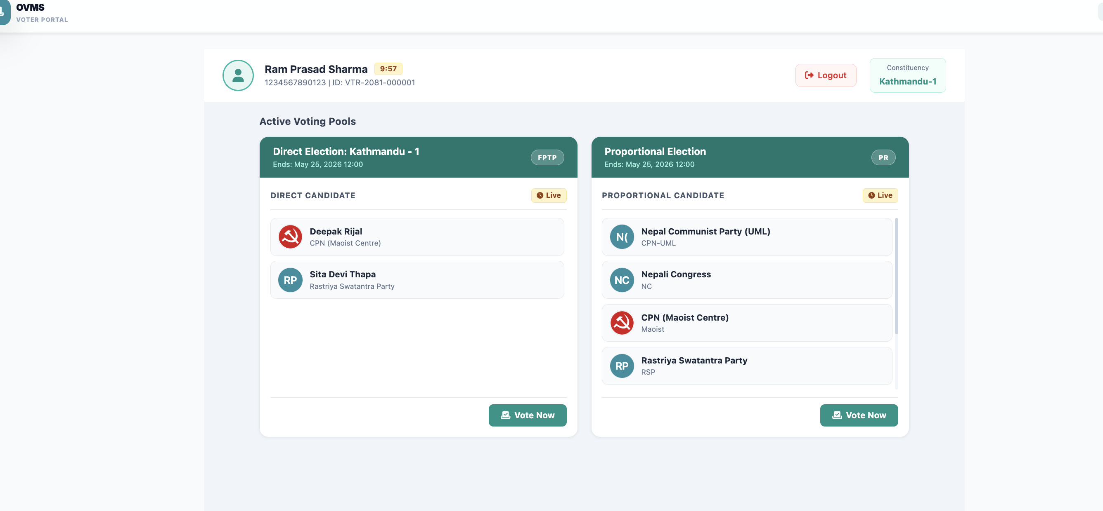
UI Prototype
Our prototype integrates secondary verification of votes
Multi-factor verification
Proper Voting UI with Swastik sign selecting

Slide 19


Security
Trust Framework Shift
Implementation of VPN & private network
Implementation of SSL /TLS
Implementation of Wazuh for secure monitoring
Secure / unaccessible config & internal files

Slide 20



Gains & lesson learned
Secure Coding: Mastered defensive programming.
Agile Mastery: Resource & sprint tracking.
Time management: Learned how to finish task in time & stay organized.
Better Teamwork: Improved how we communicate and work together.
User Feedback: Improving the app based on real-world testing.

Slide 21
Q&A
Thank you for your attention.

